Slide 1
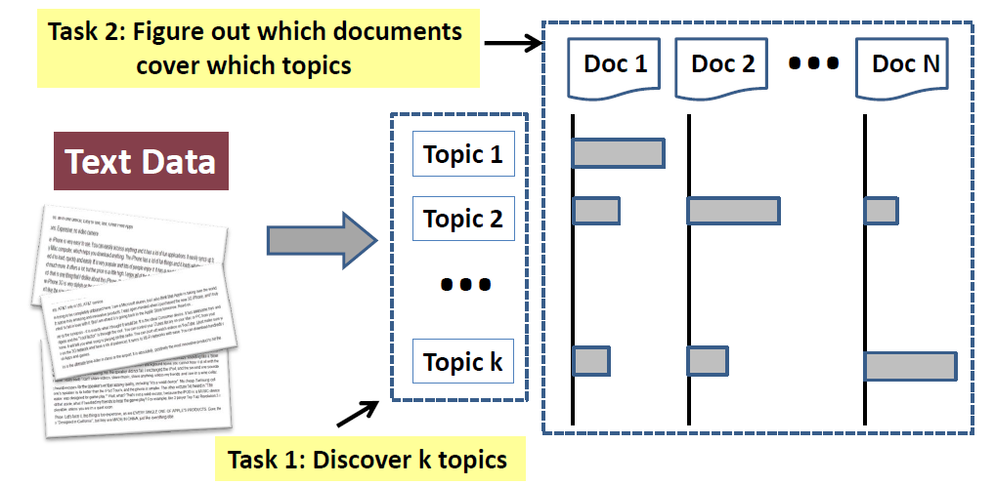
Tasks of topic mining and analysis

Slide 2

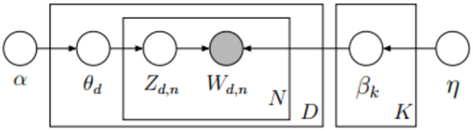
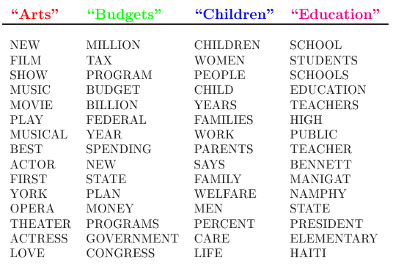
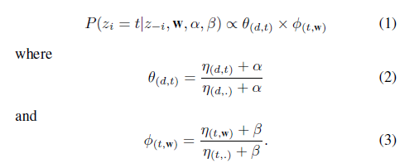
Topic Models
[1] D. M. Blei, A. Y. Ng, and M. I. Jordan, “Latent dirichlet allocation,” Journal of machine Learning research, vol. 3, no. Jan, pp. 993–1022, 2003.

Slide 3
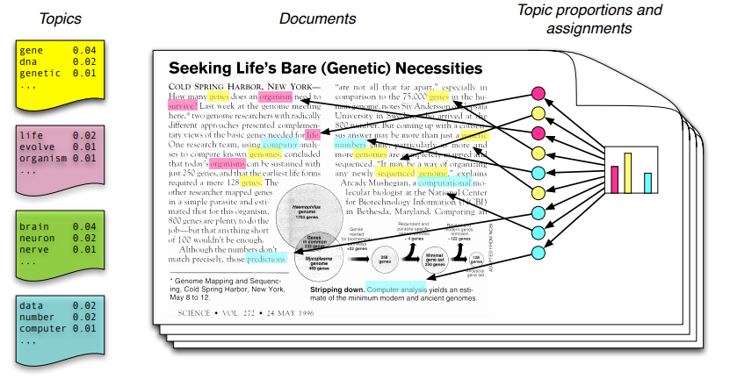
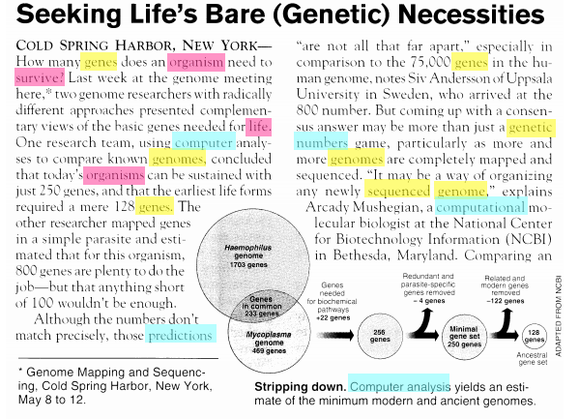

Slide 4
